Slide 1
Car Sales Analysis in the USA
Exploring Trends and Insights for Stakeholders

Slide 2

Introduction
This study delves into the analysis of car sales across the USA, examining data on various car attributes such as sales performance, type, category, discounts, and regional insights. The aim is to provide actionable insights for manufacturers, dealerships, and stakeholders to better understand the market dynamics.

Slide 3

Existing Systems Limitations
Limited analysis of regional and category trends.
Inadequate visualization of data leading to challenges in trend identification.
Minimal focus on discount and profit analysis.
Lack of correlation between sales, discounts, and profit.
Inconsistent or incomplete data handling.
Absence of predictive analysis.
Limited comparative analysis across states and categories.

Slide 4

Objectives of the New System
In-depth regional and category trends analysis.
Interactive dashboards for dynamic data visualization.
Comprehensive insights on discounts and profits.
Correlation analysis between discounts, sales, and profitability.
Efficient data cleaning and handling methods.
Predictive analysis for forecasting future trends.
Comparative analysis of performance across states and categories.

Slide 5
Scope of the Project
Analyze category performance and regional trends.
Examine the discount impact on sales performance.
Identify profitability by state and category.
Visualize the sales funnel by category.
Forecast sales trends based on historical data.
Present insights via a user-friendly interactive dashboard.

Slide 6

Data Visualization Dashboard
Dynamic visualizations to enhance stakeholder decision-making. Customization options for filtering data by various attributes.
Real-time updates for interactive charts and metrics.
Clear layout ensuring accessibility and understanding of trends.

Slide 7
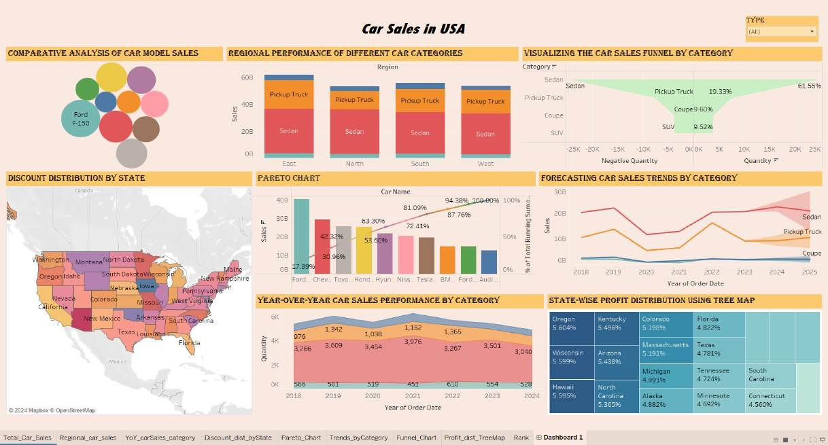

Slide 8

Expected Outcomes
Comprehensive overview of market dynamics.
Strategic insights for maximizing profit and market share.
Trend analysis aiding in competitive positioning.
Optimized pricing strategies based on insights and analytics.

Slide 9

Future Enhancements
Implementation of predictive models for sales forecasting.
Incorporation of customer sentiment analysis.
Expansion of dataset to include external market factors.
Integration of real-time data sources for a dynamic dashboard.
Development of profitability models for different segments.

Slide 10
Conclusion
The new system aims to address the limitations of existing platforms, providing comprehensive analytical tools for better decision-making in the automotive market. By understanding trends and consumer preferences, stakeholders can effectively tailor their strategies.

Slide 11

References
Kaggle, 'Car Sales Dataset', 2024. Available online: https://www.kaggle.com/datasets.
Tableau Public, 'How to Build Interactive Dashboards in Tableau', 2024. Available online:
https://public.tableau.com/en-us.
Stack Overflow, 'Custom Calculations in Tableau', 2024. Available online: https://stackoverflow.com/questions.
Towards Data Science, 'A Comprehensive Guide to Data Visualization', 2024. Available online:
https://towardsdatascience.com.

Slide 12
Thank you!

